Slide 1
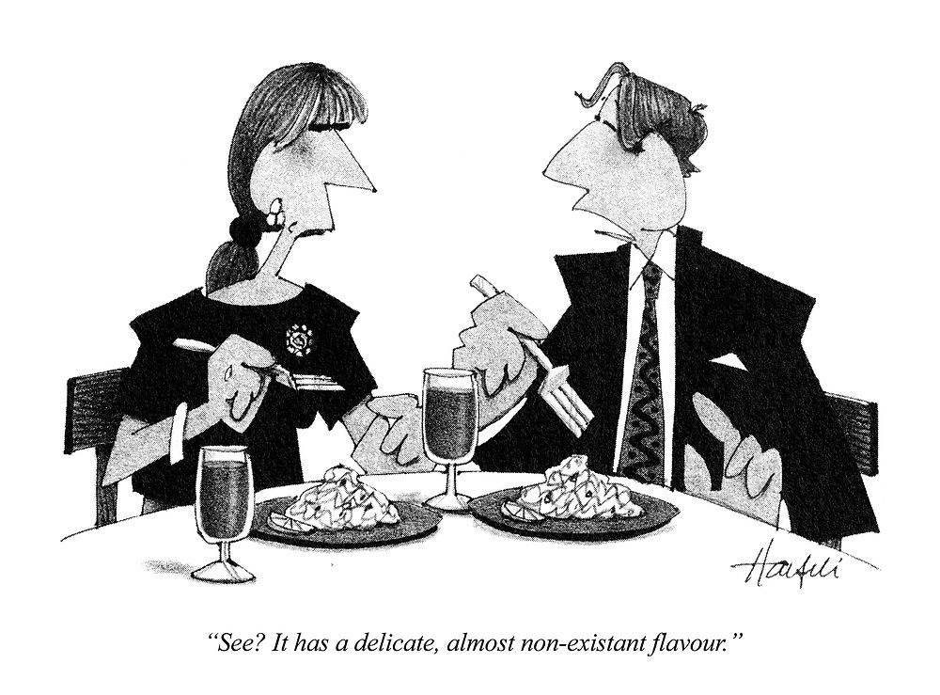
Commercial Law
(Law 2241)
RACHEL AVERY

Slide 2
This week
Non-existent goods at the time of the contract:
  Common law position
  ss.6 and 7
  Meaning of “perish”

Slide 3
Introduction
S. 6 – perishing of specific goods
  Normal expectation: an implied condition on the seller that at the time of the conclusion of the contract the goods were in existence.
    Seller warrants his right to sell goods and is responsible for defects.
    Normally should be liable if he sells non-existent goods.
But s. 6 gives rise to a presumption that the seller is not contracting that the goods exist.
    i.e. no implied condition that the goods exist
Provides a rule of construction rather than a rigid rule of law.
S.7 – perishing between agreement to sell and sale

Slide 4
Common Law positions
(4 possibilities)
Buyer may have purchased ‘a chance’
  Couturier v Hastie
Contract is void for mistake
  Bell v Lever Bros
Seller may have promised the existence of the goods
  McRae v Commonwealth Disposal Commission
Contract may be subject to a condition precedent
  AJB v Credit du Nord

Slide 5
1) BUYER MAY HAVE PURCHASED ‘A CHANCE’
S. 6 appears to be the confirmation of the decision in Couturier v Hastie:
Facts: D was an agent who sold (on behalf of C) a cargo of corn that was being shipped from Salonika. Before the date of the sale the cargo had been lawfully sold by the master of the ship so that there was no corn available for delivery to the buyer. The buyer wanted corn, not his money back so the sellers sued the agent, whose liability depended on whether the buyer would have been liable.
Held: When the contract was properly construed the agent was not liable.

Slide 6
BUYER MAY HAVE PURCHASED ‘A CHANCE’
Couturier v Hastie – construction of the contract rather than void for mistake.
  Construction of the contract
    S cannot deliver, B is not bound to pay: S. 28 SGA

Slide 7
2) CONTRACT IS VOID FOR MISTAKE
Common mistake as to existence of goods
  Goods perish that are subject matter of a contract for the sale of specific goods. They perish without the knowledge of the S and at the time of the K is made.
    K is void for mistake
    But if unascertained goods: the S has to find the amount of goods from somewhere to execute the K.
Bell v Lever Bros
  Contract not void for mistake. Right to make an employee redundant was bought and parties were merely mistaken as to how much this was worth.
  They were not mistaken as to what was being bought.

Slide 8
3) SELLER MAY HAVE PROMISED THE EXISTENCE OF THE GOODS
McRae v Commonwealth Disposal Commission
  CDC advertised for the sale of an oil tanker at Jourmand Reef. McRae agreed to buy it and incurred various expenses to conduct the salvage before it was discovered that there was no tanker.
  Held: CDC liable for breach of K as they promised that there was an oil tanker at a specific point.
  No implied condition precedent (If CDC had established that there was an implied condition precedent they would not have been liable).
  CDC promised the existence of a tanker and contracted that it would be at a specified point.
  There was no such tanker. Therefore, breach of K and B is entitled to sue for damages.

Slide 9
SELLER MAY HAVE PROMISED THE EXISTENCE OF THE GOODS
S. 6 not applied in McRae. Why?
  Goods had never existed, thus they never had perished.
  CDC contracted to sell a ship and warranted that they had a ship to sell. Thus in the absence of the ship they would be liable to pay damages.

Slide 10
SELLER MAY HAVE PROMISED THE EXISTENCE OF THE GOODS
Goldsborough v Carter
  Carter agreed to sell ‘about’ 4000 sheep pastured on certain land (specific goods). If it should be found less than 4000 sheep B would pay for the actual number delivered. Only 890 sheep were found. B claimed damages for short delivery.
  Held: implied condition that the sheep were or would be in existence and that they should be in existence at the time for performance. BUT S did not know how many sheep there were, B was aware of shortage possibility and agreed to take less. Therefore the K was only for the sheep that existed and could be delivered on muster.

Slide 11
4) Contract may be subject to a condition precedent
Associated Japanese Bank v Credit du Nord SA
  Mr. B wanted to borrow money from AJB. AJB bought 4 machines for £1m and leased them back for £1m plus interest. Credit Nord guaranteed Mr. B’s obligations under a sale and leaseback agreement. Mr. B was arrested for fraud as the machines did not exist at all. AJB claimed the monies from Credit Nord.
  Held: Credit Nord did not have to pay. The guarantee was subject to an express condition precedent that the machines existed and if they did not Credit Nord was entitled to treat the agreement as repudiated.
Rule to remember: In a sale and leaseback contract the S is guaranteeing the existence of the goods.

Slide 12
Non-existent goods
S of non-existent goods may be held liable on the basis that the goods have been impliedly or expressly warranted to exist.
S. 6 requires that goods have existed but have perished before the K was made.
  McRae and AJB would not come within its scope because no goods ever existed.
  S should be liable for breach of K – as in the common law position
  .
But what about s. 6? Will the contract be avoided? Yes!
Liberal interpretation of s. 55(1)(exclusion of implied terms) – sections can be varied provided they do not affect third party rights: McRae.

Slide 13
Non-existent goods
True construction of the K is that if the S is contracting that the goods exist S. 6 will not apply and the S will be liable for non-delivery. S. 6 becomes subject to the terms of the K (K’s can be construed wider than s. 6 intended).
  Joseph Constantine SS Ltd v. Imperial Smelting
The only effect of s. 6 is to give rise to a presumption that the S is not contracting that the goods exist.
  Thus it is a rule of construction rather than a rigid rule of law.

Slide 14
Non-existent Goods
KEY THING TO REMEMBER:
In cases like McRae where the goods have never existed s. 6 cannot apply and the presumption may be that the seller is contracting that the goods exist.

Slide 15
Meaning of Specific Goods
S. 61 – goods identified and agreed upon at the time a contract of sale is made.
Distinguished from future and generic goods.
  HR & Sainsbury v Street
    Sale of 275 tons of barley to be grown on a particular farm. Importantly this was not a sale of specific goods. Only 140 tons was produced and the Defendant delivered it to a 3rd party.
    Held: K was frustrated as to the failed part of crop but the Defendant was not exonerated from offering the produced bit.
      Effect of perishing of these goods are not within s. 6 but a matter of common law.

Slide 16
Effect of part of goods perishing
What happens where there is a sale of specific goods part of which have perished before the date of the sale?
  Barrow v Phillip
    K for a specific lot of 700 bags of nuts. 109 bags had been stolen before the K was made but 150 bags were nonetheless delivered to B before B found out about the theft. P sued B for the price of 700 bags.
    Held: s. 6 applied since the parcel of 700 bags had perished when the 109 were stolen. Contract was avoided.
    The K was for a parcel of 700 bags and at the time the K was made there were only 591 bags. The B was not contracted to buy 591 bags.

Slide 17
Meaning of perish
Both physical destruction and perishing in the commercial sense must be considered.
Asfar v Blundell
  Consignment of dates aboard a ship sank in the Thames and were contaminated by sea and sewage. After salvage they were unfit for human consumption but still fit for distillation.
  Held: for insurance purposes the cargo was held to be a constructive total loss.
Q: Has the nature of the goods been altered? Yes -unfit for human consumption. No - they were still dates. Which?!

Slide 18
Meaning of perish
Horn v Minister of Food
  Potatoes had rotten so as to be worthless. Morris J held that they had not perished within the meaning of s. 7 as they were still potatoes
A seller who contracts to sell a specific lot of potatoes will be liable for breach of his implied obligations if he delivers unmerchantable goods.
Immaterial whether they were unmerchantable before the K was made.
If s. 6 is successfully utilised liability will be escaped.

Slide 19
Meaning of perish
What about goods lost by theft?
  Barrow v Phillips
  If there is no real prospect of recovering goods they should be treated as having perished within the meaning of s. 6.

Slide 20
Unascertained goods
ss. 6-7 apply to only specific goods, but what about unascertained goods? Can they perish?
Generic Goods
  Goods sold by pure description
    E.g. 100 tons of Santini tomatoes.
  S takes all responsibility in ensuring the goods respond to the description and will be delivered to the B on the agreed date. All risks incidental to seeing that the goods are supplied are also borne by S.

Slide 21
Unascertained goods
Intertradex v Lesieur
  Intertradex agreed to sell 800 tons of Mali groundnut to Lesieur. Suppliers SEPOM failed to meet their commitments. Sellers claimed that they were excused from performance.
  Arbitral tribunal held Sellers were excused.
  The first instance court (affirmed by CA) held they were not excused:
    Sellers assumed basic risks (shortage of supply and a rise in price), hence the high price to provide profit for Sellers. K had not been frustrated.

Slide 22
Unascertained goods
Goods to be manufactured or acquired by the seller
  Shipbuilder agrees to build a yacht and it is destroyed by fire when it is largely finished. The Seller/manufacturer has to start rebuilding all over again.
  Risk borne by the Seller.
  Parties may agree otherwise.

Slide 23
Unascertained goods
Goods which are to be appropriated from a specific bulk or source
  Different rule. A sales K will be impossible to perform if the source from which the goods are to be appropriated fails.
  100 tons of Santini tomatoes out of the 200 tons now in the Seller’s store. If the 200 tons are destroyed the K will be frustrated.
  Howell v Coupland
    K for the sale of 200 tons of Regent potatoes. Only 80 tons produced due to disease.
    H took delivery and sued for damages for the failure to deliver the balance.
    Held: Failure should be excused.

Slide 24
Next week
Post Contractual Loss of Goods and Other Forms of Subsequent Impossibility

